Slide 1
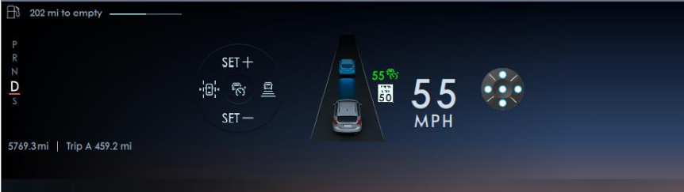

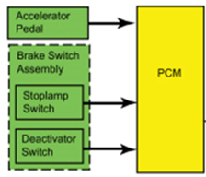
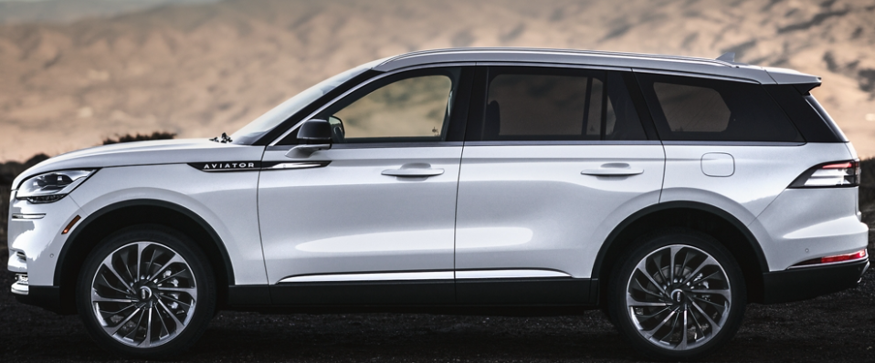
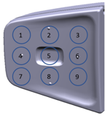
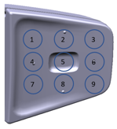

Improved Steering Horizon Controller Boundary Diagram
Customer Output
Customer Input – Switch button push
SYNC+ Domain Controller
Lpos_1
Lpos_2
Lpos_3
Lpos_4
Lpos_5
Lpos_6
Lpos_7
Lpos_8
Lpos_9
Lprespos_1
Lprespos_2
Lprespos_3
Lprespos_4
Lprespos_5
Lprespos_6
Lprespos_7
Lprespos_8
Lprespos_9
DAT-ACC
on
off
Can
Lateral Control
Res +
Set -
Gap
Switch status signals
Cruise Control Network Diagram
CC Actuator
Feature actuation signals
Menu
Menu
Menu up
Menu down
OK
RADIO/PPT
PPT
Vol +
Vol -
Seek left
Seek right
Phone
Phone - Accept
Phone - Reject
Vol +
Vol -
St Column
Tilt +
Tilt -
Tele +
Tele -
Mirror LH
Tilt +
Tilt -
Tele +
Tele -
Mirror RH
Tilt +
Tilt -
Tele +
Tele -
HS3-CAN
PCM
HS1-CAN
Private
CAN
ECG2
Enhance central Gateway
SIMA
Switch input Module A
HS2-CAN
SCCM
Steer Column Control Module
FD3-CAN
BCM
Body Control Module
Rpos_1
Rpos_2
Rpos_3
Rpos_4
Rpos_5
Rpos_6
Rpos_7
Rpos_8
Rpos_9
Rprespos_1
Rprespos_2
Rprespos_3
Rprespos_4
Rprespos_5
Rprespos_6
Rprespos_7
Rprespos_8
Rprespos_9
Summary
Utilized SYNC+ domain controller to to translate 18 switch signal logic combination to more 60 CAN signals.
No need new ECU module.

